Slide 1


School Leader Workload: What does the evidence tell us and how should we respond?
Phil Riley
SASSLA State Conference
May 20, 2022

Slide 2


Slide 3
The Workday Challenge
Wanted: A miracle worker who can do more with less, pacify rival groups, endure chronic second-guessing, tolerate low levels of support, process large volumes of paper and work double shifts (75 nights a year). He or she will have carte blanche to innovate, but cannot spend much money, replace any personnel, or upset any constituency
Evans (Education Week, April 12, 1995)

Slide 4
Context: Historical Working Hour Limits
1930 the ILO set maximum working week at 48 hours
This remains the current hour limit beyond which, according to the ILO, no worker should exceed because of the potential health and safety risk.”
These limits were set for a paid workforce that was largely male, at a time when gender divisions were normative and paid work and caregiving separate endeavours.
Now, in developed economies such as Australia, nearly two thirds of working-age women are in the labour force.
(Dinh, Strazdins, & Welsh, 2017)
Notes:
These limits were set for a workforce that was once largely male, at a time when gender divisions were normative and paid work and caregiving separate endeavours. Now, in developed economies such as Australia, nearly two thirds of working-age women are in the labour force (one third in 1961, one fifth in 1947 Strachan and Burgess, 2002; Wilkins and Wooden,
2014).
Dinh, H., Strazdins, L., & Welsh, J. (2017). Hour-glass ceilings: Work-hour thresholds, gendered health inequities. Social Science & Medicine, 176, 42-51. doi:http://dx.doi.org/10.1016/j.socscimed.2017.01.024

Slide 5
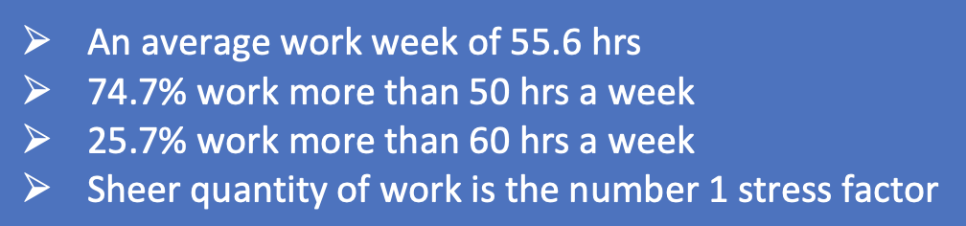
Australian Principals’ Average Workload 2021

Slide 6
Working Hours & Health
US Dept of Health Report
Working >10 hours a day led 60% increased risk of cardiovascular disease
10% working 50–60 hours a week report relationship problems, and 30% for those working more than 60 hours.
Working >40 hours per week is associated with
  increased alcohol and tobacco consumption
  unhealthy weight gain in men
  depression in women
Little productive work occurs after 50 hours per week. In white collar jobs, productivity declines by ~25% when workers put in 60 hours or more.
(Caruso, Hitchcock, Dick, Russo, & Schmit, 2004).

Slide 7
Work Hours, Gender & Health
Dinh, Strazdins & Welsh, 2017 HILDA data 13,969 participants 7682 households
"Women's mental health scores began to track lower than men's once they worked more than 35 h, a slight drop in men's scores occurred after they worked more than 50 h, yielding preliminary evidence for gendered and non-linear workhour-health relationships" (p.45)
"Beyond this threshold [39 h/p/w], the mental health of the average Australian working adult aged 24-64 deteriorated”. (p.47)
"we found a 13 hour gender gap in the tipping point at which mental health deteriorates
(46.7 h men; 34.1 h for women)”. (p.47)
On average, men: 44 hours at paid work 21 hours on care and housework
                women: 33 hours at paid work 31 hours on care and housework
(p.47)
Notes:
Disentangling the health influence of workhours is complex because health and how long people work mutually influence each other, that is, health is endogenously determined by work time. Thus healthy people are much more likely to work long hours and earn better wages, while unhealthy people curtail their hours or leave the labour market altogether. This creates countervailing influences between work time, wages and health (both mental and physical) which few studies systematically address. Grossman and Benham (1974) argue that the simultaneous estimation of three variables - workhours, wages and health e is needed to estimate robust workhour-health thresholds. This has not, to our knowledge, been undertaken;
Model 2 (now 46.7 h for men and 34.1 for women). The gender gap increased from 5 to 13 h (Fig. 1 a3), indicating that men's and women's resources and time constraints differentially affected workhour-health thresholds, amplifying women’s workhour-health vulnerability.
Dinh, H., Strazdins, L., & Welsh, J. (2017). Hour-glass ceilings: Work-hour thresholds, gendered health inequities. Social Science & Medicine, 176, 42-51. doi:http://dx.doi.org/10.1016/j.socscimed.2017.01.024

Slide 8
Hour-glass ceilings: Work-hour thresholds, gendered health inequities
Australian National University Report (Dinh, Strazdins & Welsh, 2017)
High domestic workloads (>20 h a week)
+ with long work hours (>40 h per week)
_______________________________________
Poor sleep in both men and women
Physical inactivity in women
Notes:
Dinh, Strazdins, & Welsh (2017), analysed the HILDA data (Household, Income and Labour Dynamics in Australia Survey) that began in 2001.”HILDA is a nationally representative household-based panel study of Australian adults aged 15 years and over that began in 2001 (Wave 1, 7682 households representing 66% of in-scope households; 13,969 people interviewed). Every year, the survey asks respondents about their employment and family circumstances, health and socioeconomic characteristics through face-to-face interviews and self complete questionnaires. Response rates are consistently high (86% retention in wave 2, above 90% thereafter; see Summerfield, 2011).
Hour-glass ceilings: Work-hour thresholds, gendered health inequities. Social Science & Medicine, 176, 42-51. doi:http://dx.doi.org/10.1016/j.socscimed.2017.01.024

Slide 9
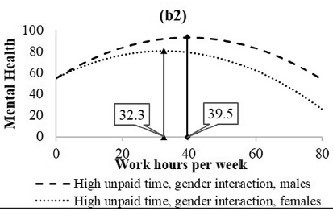
Mental health begins to decline at 10 hours below the ILO limit and 20 hours below the average working hours for most principals
Ireland
Aust / NZ

Slide 10
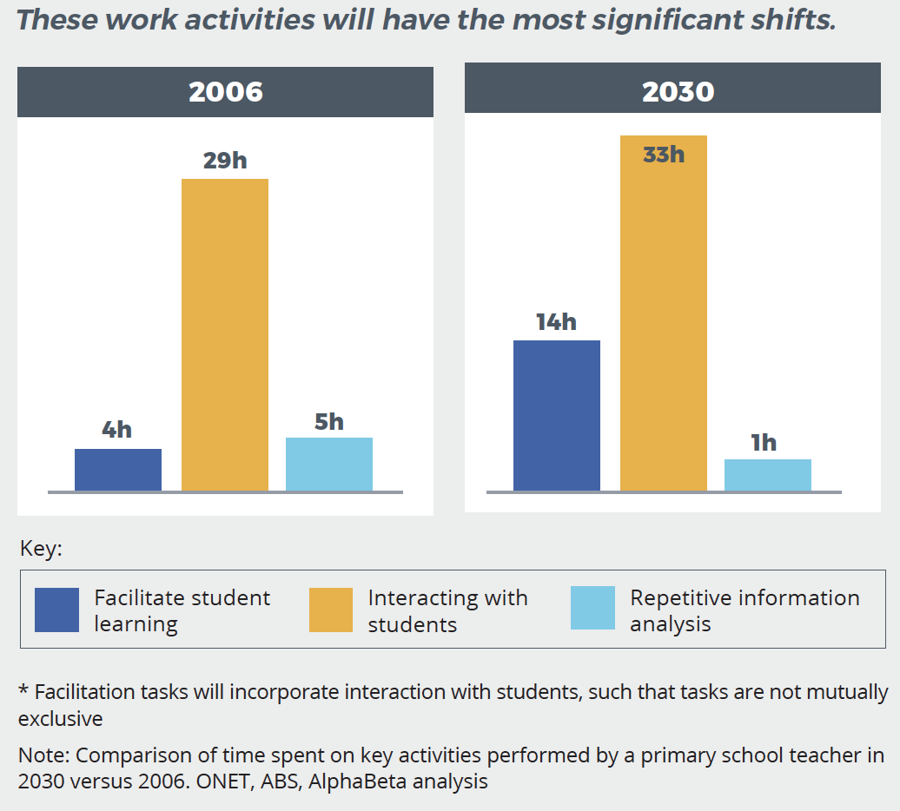

37 hrs
48 hrs
No thoughts about 11 h/p/week extra workload
What work can be taken away…
Administrivia
Foundation for Young Australians. (2017). The new work smarts: Thriving in the new work order.
Retrieved from http://www.fya.org.au/wp-content/uploads/2017/07/FYA_TheNewWorkSmarts_July2017.pdf
Notes:
Future teacher (Exhibit 3): The growing use of automation and digital learning tools will notably change how teachers do their jobs. New software will take over an increasing volume of routine tasks, such as grading work. This will give teachers more time to interact with students. By 2030, teachers will routinely use digital technology to make classroom education a more interactive, student-centred experience. This means they will likely spend less time lecturing and more time facilitating self-directed learning.

Slide 11

Death from Overwork (Annual)
Japan: karoshi 10,000
China: guolaosi 600,000 (1,600 per day)
USA: 120,000
+ >600,000 sudden acute myocardial infarction (MCI)
in people with no previous symptoms
Peak period for MCIs: 9am Monday mornings
Australia (10,000 + 120,000 MCIs)
Principals: ?? Teachers ?? Academics ??
Notes:
Chinese Academy of Social Sciences ascertained that as many as 70 percent of China's intellectuals currently faced, to a greater or lesser extent, the risk of premature death from exhaustion. The survey report also found that in the cities along China's eastern and southern coast, where the development of specialized skills and technology is particularly advanced, the problem of death from exhaustion among intellectuals was growing steadily more acute and the average age of those dying from overwork was getting steadily lower.
A marked circadian rhythm in the frequency of onset was detected, with a peak from 6 a.m. to noon (P<0.01 ). In 703 of the patients, the time of the first elevation in the plasma creatine kinase MB (CK-MB) level could be used to time the onset of myocar­dial infarction objectively. CK-MB-estimated timing con­firmed the existence of a circadian rhythm, with a three­fold increase in the frequency of onset of myocardial infarction at peak (9 a.m.) as compared with trough (11
Muller, J. E., Stone, P. H., Turi, Z. G., Rutherford, J. D., Czeisler, C. A., Parker, C., . . . et, a. (1985). Circadian variation in the frequency of onset of acute myocardial infarction. The New England Journal Of Medicine, 313(21), 1315-1322.

Slide 12
Social Pollution
Health Costs
USA $200 Billion
Aust $16.66 Billion (PwC $10.9 Billion in 2014)
Turnover Costs
USA $300 Billion
Aust $25 Billion
Alcohol abuse, chemical dependence, weight gain, family relationship problems and even post-traumatic stress disorder (PTSD) have been documented with increasing frequency (Pfeffer, 2018).
Notes:
Chinese Academy of Social Sciences ascertained that as many as 70 percent of China's intellectuals currently faced, to a greater or lesser extent, the risk of premature death from exhaustion. The survey report also found that in the cities along China's eastern and southern coast, where the development of specialized skills and technology is particularly advanced, the problem of death from exhaustion among intellectuals was growing steadily more acute and the average age of those dying from overwork was getting steadily lower.

Slide 13

Whitehall studies
“job control was the single most important predictor of developing heart disease – more important even than smoking, for instance, in accounting for developing CHD [coronary heart disease]” (Pfeffer, 2018, p. 149).

Slide 14
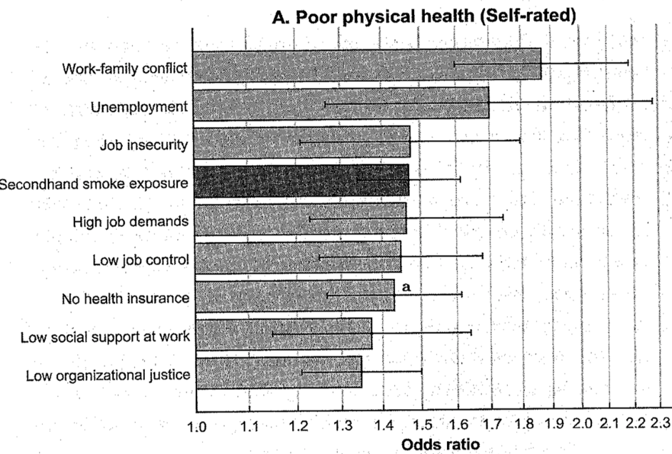

Slide 15
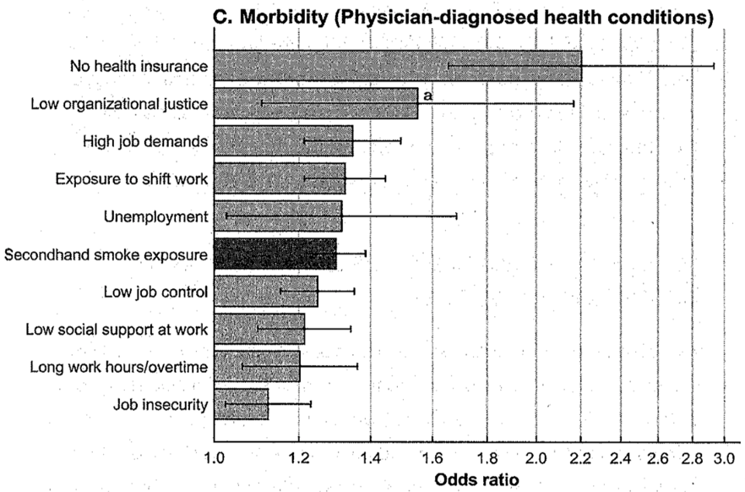

Slide 16
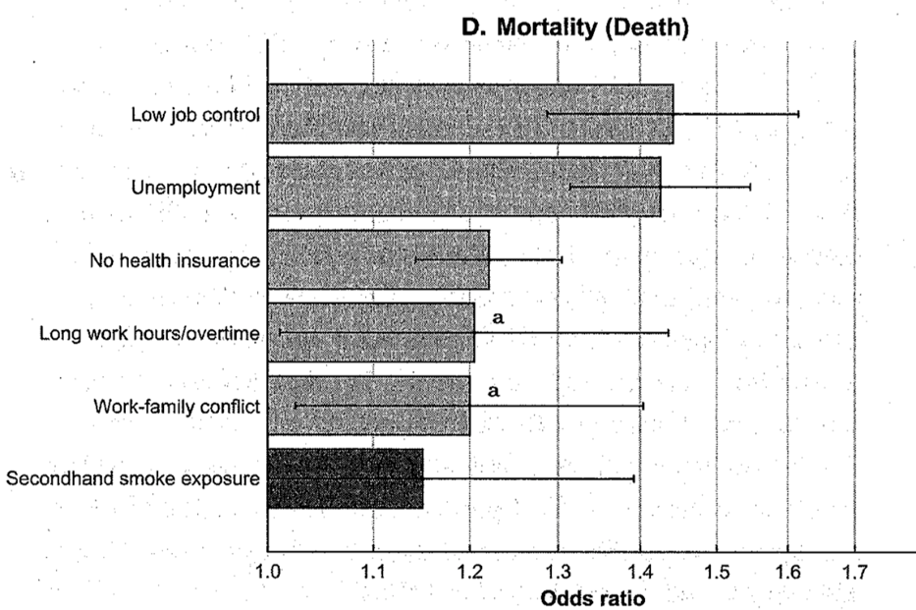

Slide 17
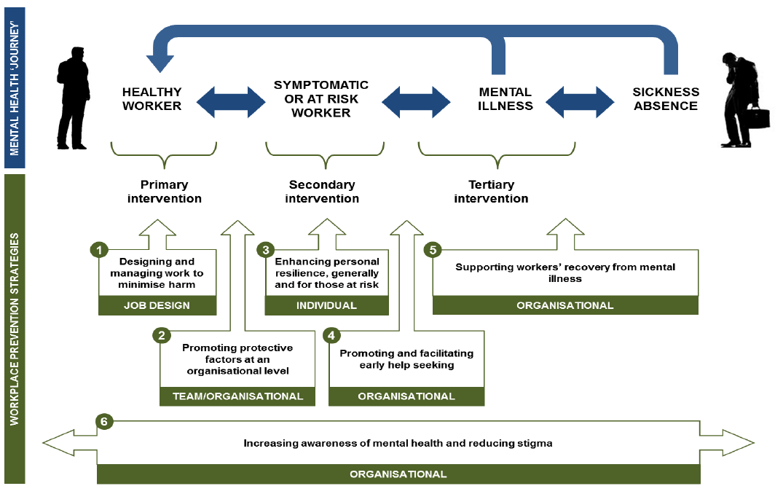
(Harvey, et. al., 2014)
Notes:
Harvey, S. B., Joyce, S., Tan, L., Johnson, A., Nguyen, H., Modini, M., & Groth, M. (2014). Developing a mentally healthy workplace: A review of the literature: National Mental Health Commission and the Mentally Healthy Workplace Alliance.

Slide 18
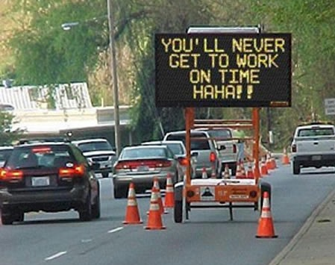
Accept what you cannot change

Slide 19
Don’t accept what you can change
Primary Level OH&S reform
  Occurs in the policy realm
  Will only change through your collective action
Secondary OH&S Interventions will help
  e.g. Mindfulness, exercise, taking time out for family, friends etc.
  Take individual responsibility
Tertiary OH&S Interventions
  Wait for people to break before intervening

Slide 20

Not problems…challenges!

Slide 21
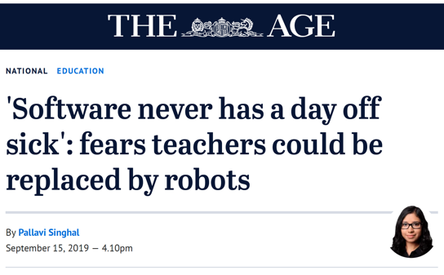

Two Futures: the alternative

Slide 22
Two Futures:Data Fusion & Mining to Enrich Lives
Those who can exploit the opportunities that big data mining and machine learning offer will be those who profoundly shape education.
Educators need to be at the forefront of this transformative development, not bit players.
Notes:
by linking scholars in Arts, Education, Science, Economics Engineering, Built Environment, Health and eSolutions to form a Strategic Research Centre focussed on transforming education, but keeping educators in control.

Slide 23
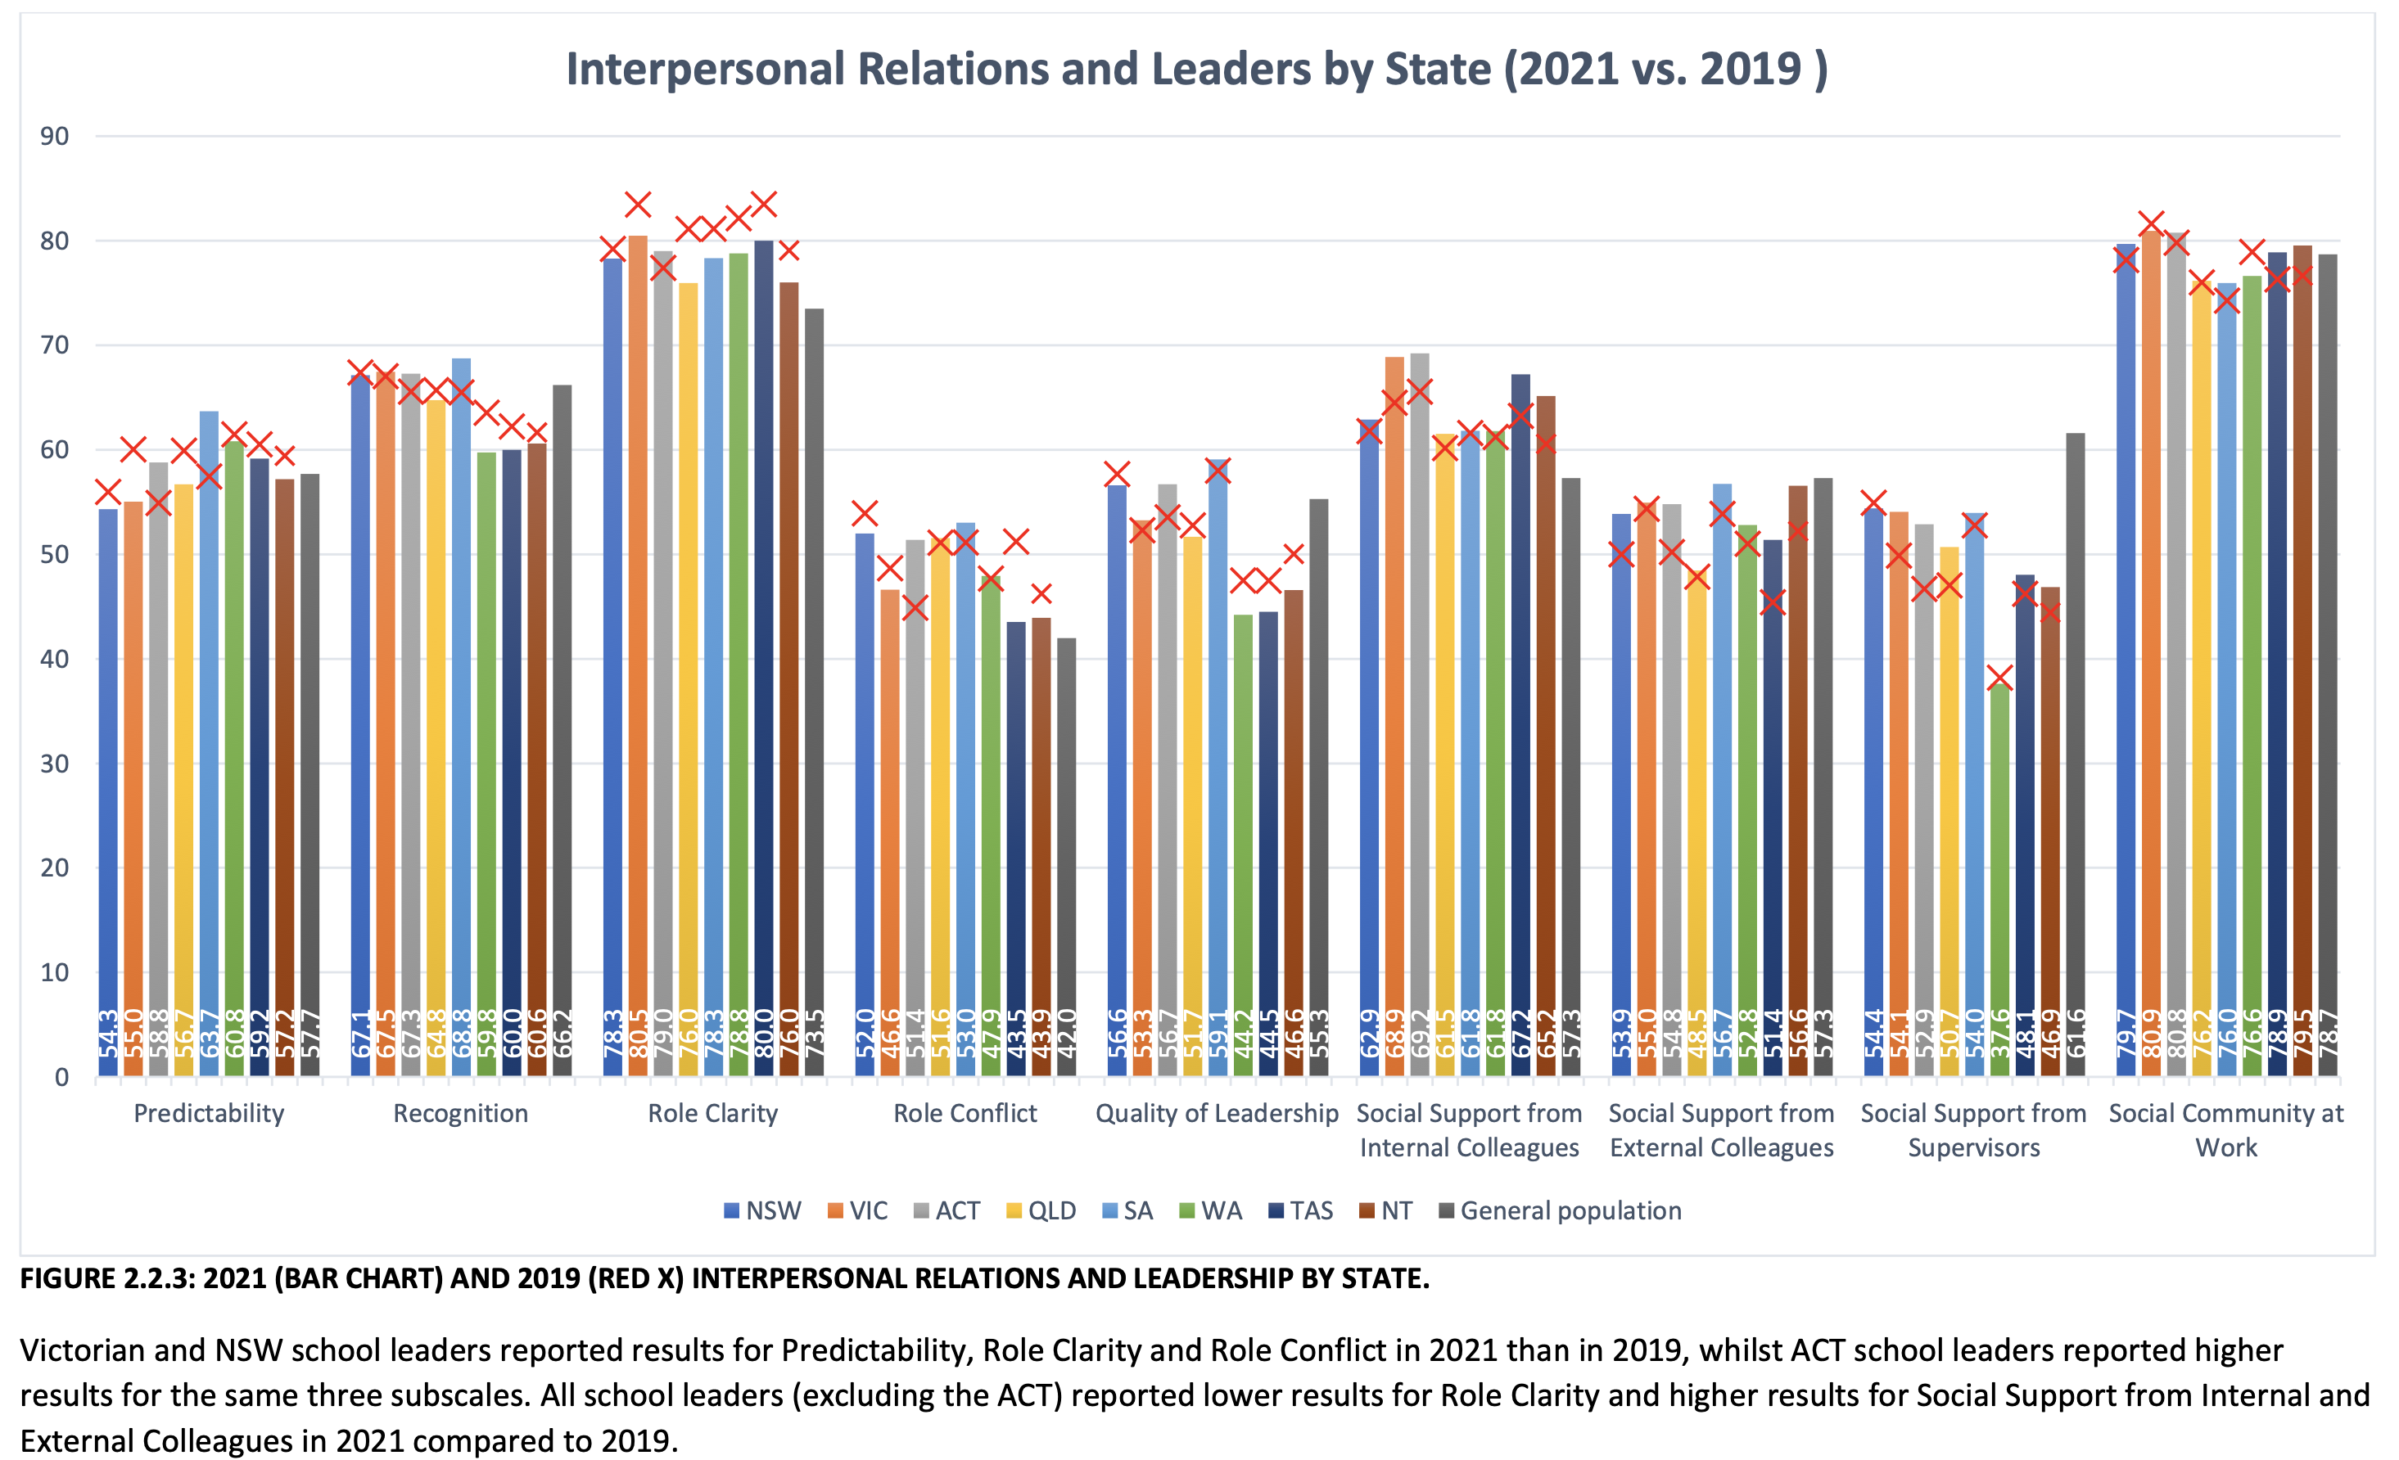

Slide 24
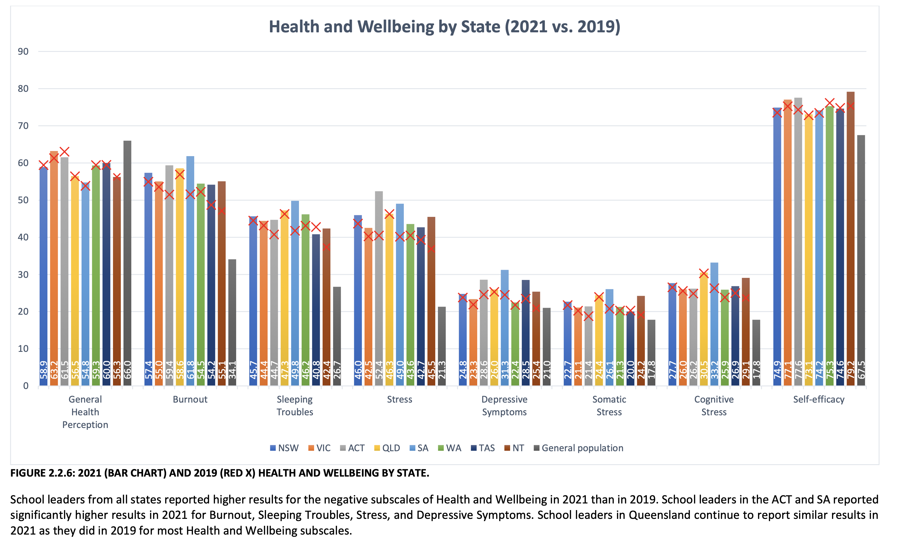

Slide 25
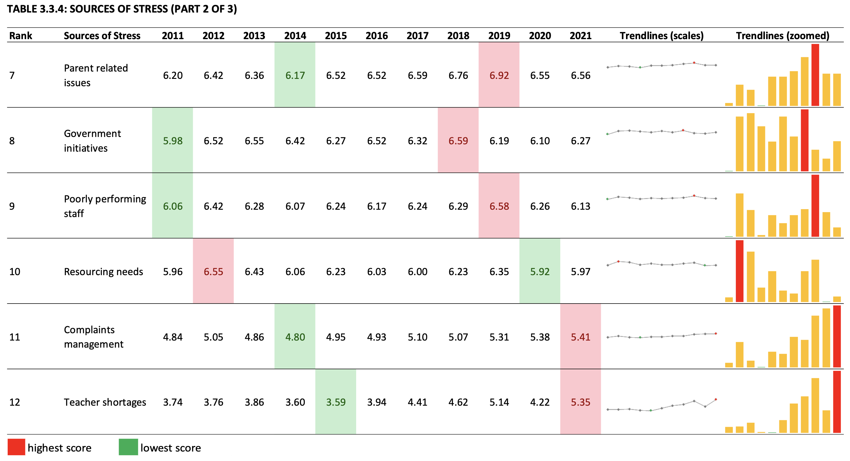

Slide 26
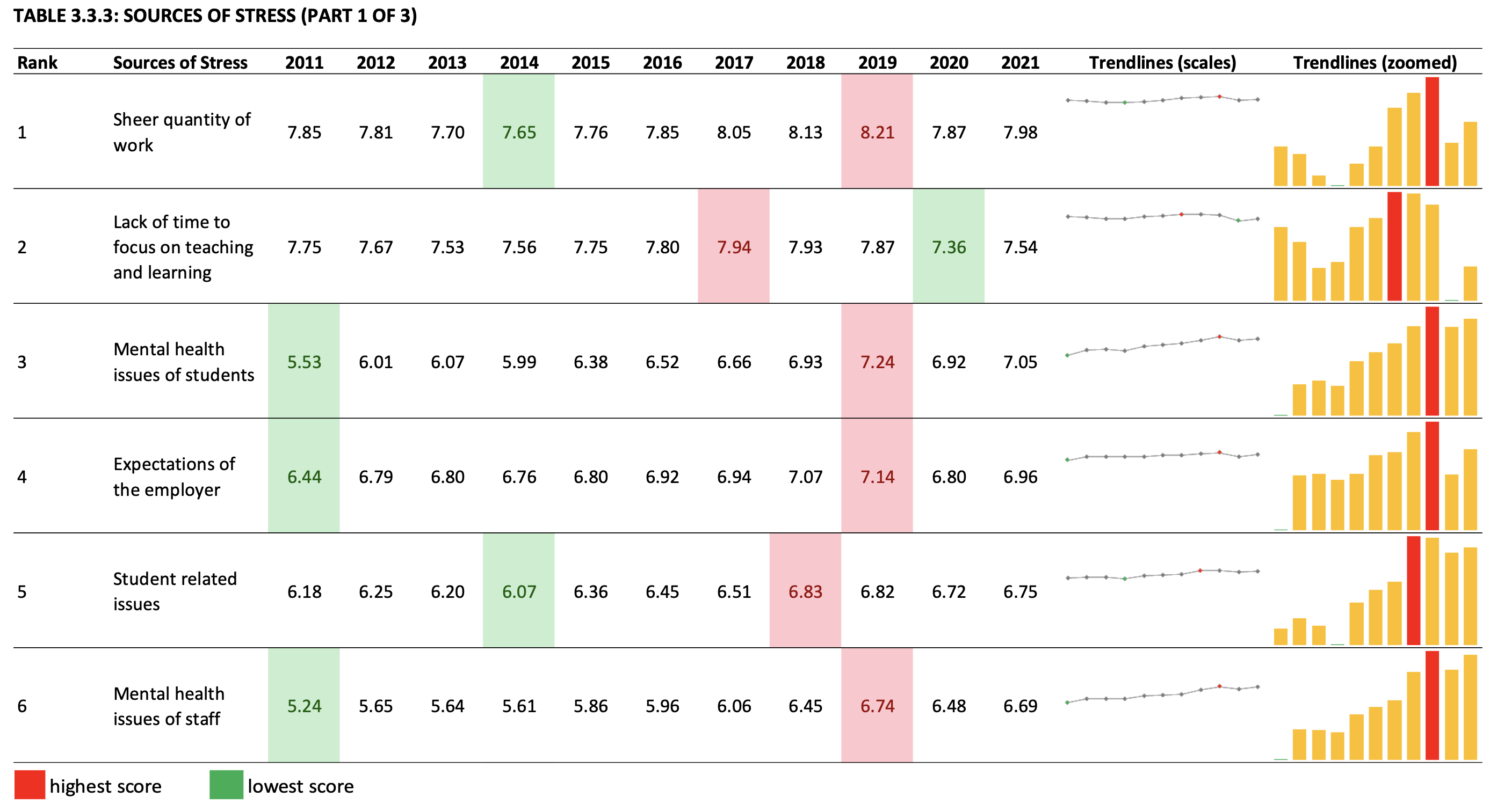

Slide 27
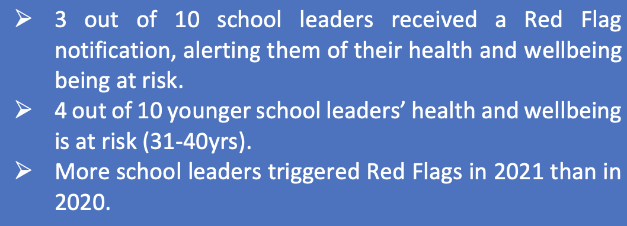

Slide 28
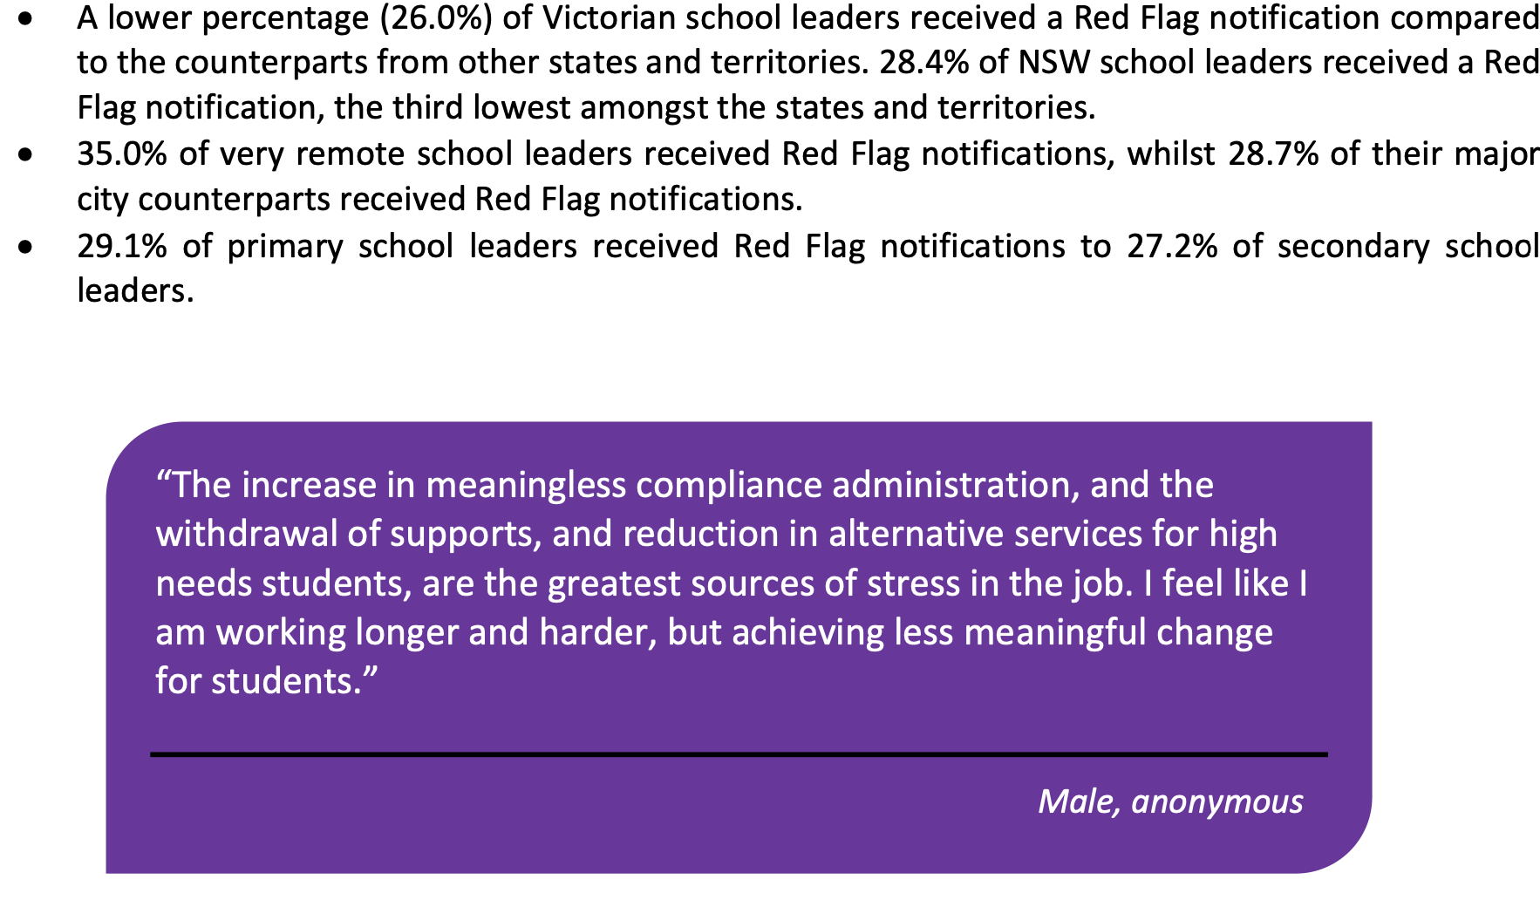

Slide 29
24.6 h/p/w (41%) on administrative and accountability tasks
31.8 h/p/w (59%) on educative tasks

Slide 30
Services | Proactive |  |  |  |  | Responsive
 | School Policy Template Portal | Principal Mentor Program | Professional Supervision | Personal Health Checks |  | Complex Matter Support Team | Early Intervention
 | Suite of online, relevant policy templates meeting legal, Departmental policy, and school registration requirements. Easily adapted for each school and updated regularly | On demand access to experienced principal mentors, who are trained in psychological first aid | Opt in allied health model, bi-annual debriefing sessions with and experienced psychologist. Proactive checkins with new principals 6-8 week post starting | Access to physical and mental health checks. Detailed health assessment report. |  | A Lead Professional will: Coordinate and connect principals with supports from a number of areas Assist with [legal] responding to correspondence from parents and advocates | Support for illness, injury or early warning signs of health and wellbeing issues

Slide 31
Usage: Principal Health and Wellbeing services end Oct 2019
School Policy Templates Portal
o Usage: 394,688 page views with 33,232 unique users
Principal Mentor Program (to reduce isolation and build social capital)
o Uptake: 140 mentee applications
Proactive Wellbeing Supervision (to provide opportunities to debrief with experienced psychologists and new starter check-ins)
o Uptake: 91 principals
Principal Health Checks (free and confidential physical and mental health consultations)
o Usage: 532 completed health checks
Complex Matter Support Team (to minimise workload and stress associated with managing and responding to complex cases)
o Uptake: 299 cases supported by the team
Early Intervention Program (to provide professional support to prevent health and wellbeing risks from escalating)
o Uptake: 476 principals accessed this service

Slide 33
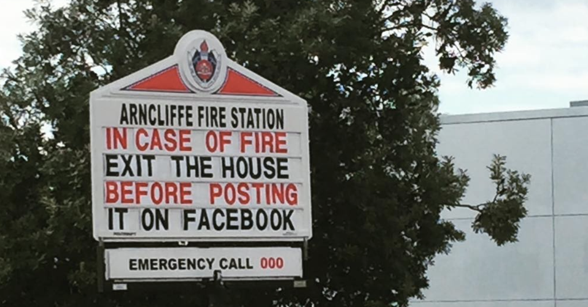
Get the Priorities Right!

Slide 34

Priorities (Pfeffer)
Measure health and well-being in the same way as environmental pollution and impact.
Call out social polluters for their toxic practices and workplaces and force them to change, using social pressure.
Develop social policies that reflect the true costs and consequences of these toxic practices so that companies pay their share of the costs of the ill health they create.

Slide 35
Priorities (Pfeffer)
Anticipate excuses from those companies that will refuse to confront the issue. This is not an industry-specific issue, nor a nature-of-the-beast issue.
We must insist that organizational leaders prioritize the issue instead of just paying lip-service and then sacrificing any commitments at the first sign of economic distress.

Slide 37
Where to next?
Analyse relationships between policies, working conditions and health and wellbeing
Develop robust, innovative, digital methodologies
Raise awareness among educators, policymakers and other stakeholders
Develop robust, longitudinal evidence about occupational health safety and wellbeing in the education workforce
Make significant contributions to academic theory, methods and evidence regarding the education workforce

Slide 38




Research Infrastructure: surveys and reporting systems
Data Governance
In-house data storage for all parts of the systems
Implying advanced methods of authentications and data security for access
Complies with Australian and international Data Protection Regulation
Surveys
Multiple online surveys developed on COPSOQ-II and COPSOQ-III
Different cohorts of principals, teachers, ECE educators, academics
Multi-sectorial
Dashboards and Reporting systems
Interactive dashboards of survey results for all participants
Interactive graphs/charts for key components of work environments
Written report with summary of key findings
EducatorHealth App
  Interactive report for participants upon completion of survey
  raise awareness about educators’ working conditions
  Overview of working conditions and health status

Slide 39
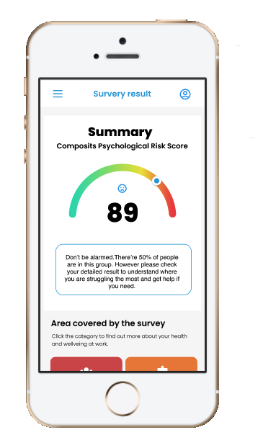
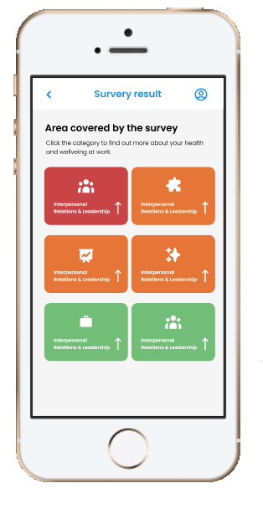
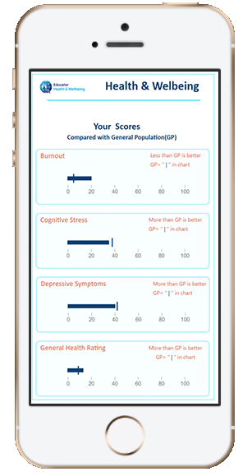
Personalised Individual reports for participants
Personalised Information: key components of work and wellbeing
Key Areas of Work
Summary of individual survey results

Slide 40
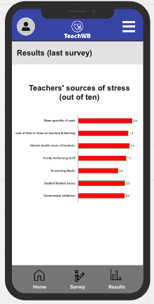
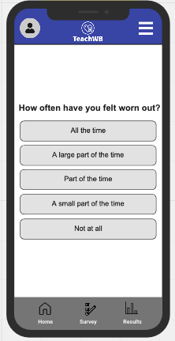
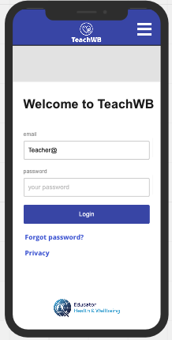
TeachWB app
Track the work, health and wellbeing of teaching professionals over time
Provide key stakeholders with real-time data about the workforce
Identify challenges facing the teaching profession
Support the deployment of targeted support (e.g. tracking the return to work for the 2022 school year)
Notes:
Here is an illustration of the app
Connect educators with key stakeholders – rapid response to issues and regular tracking over time

Slide 41
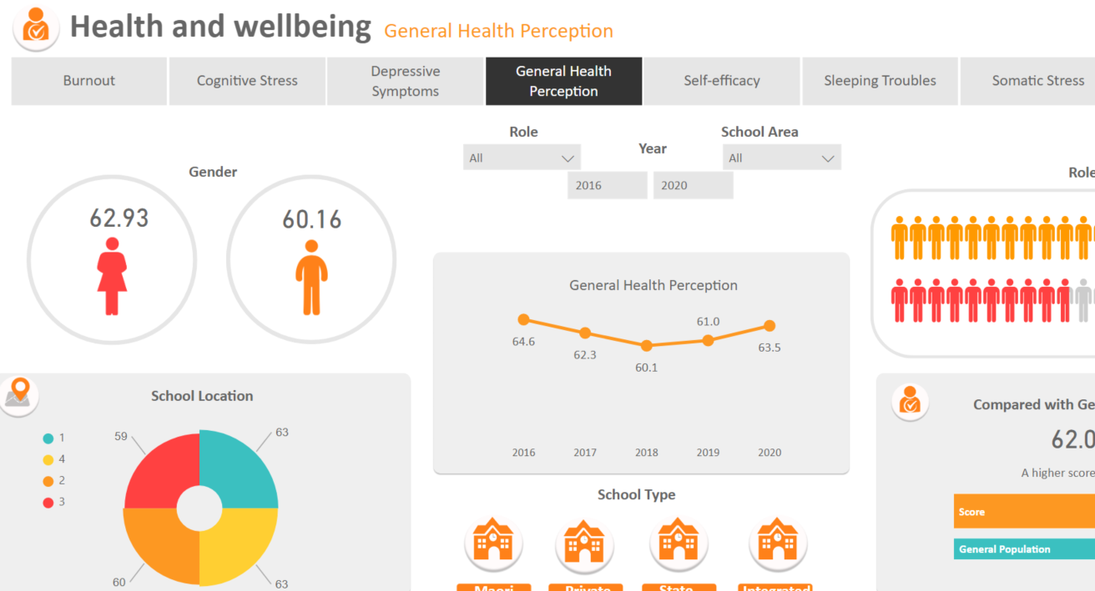
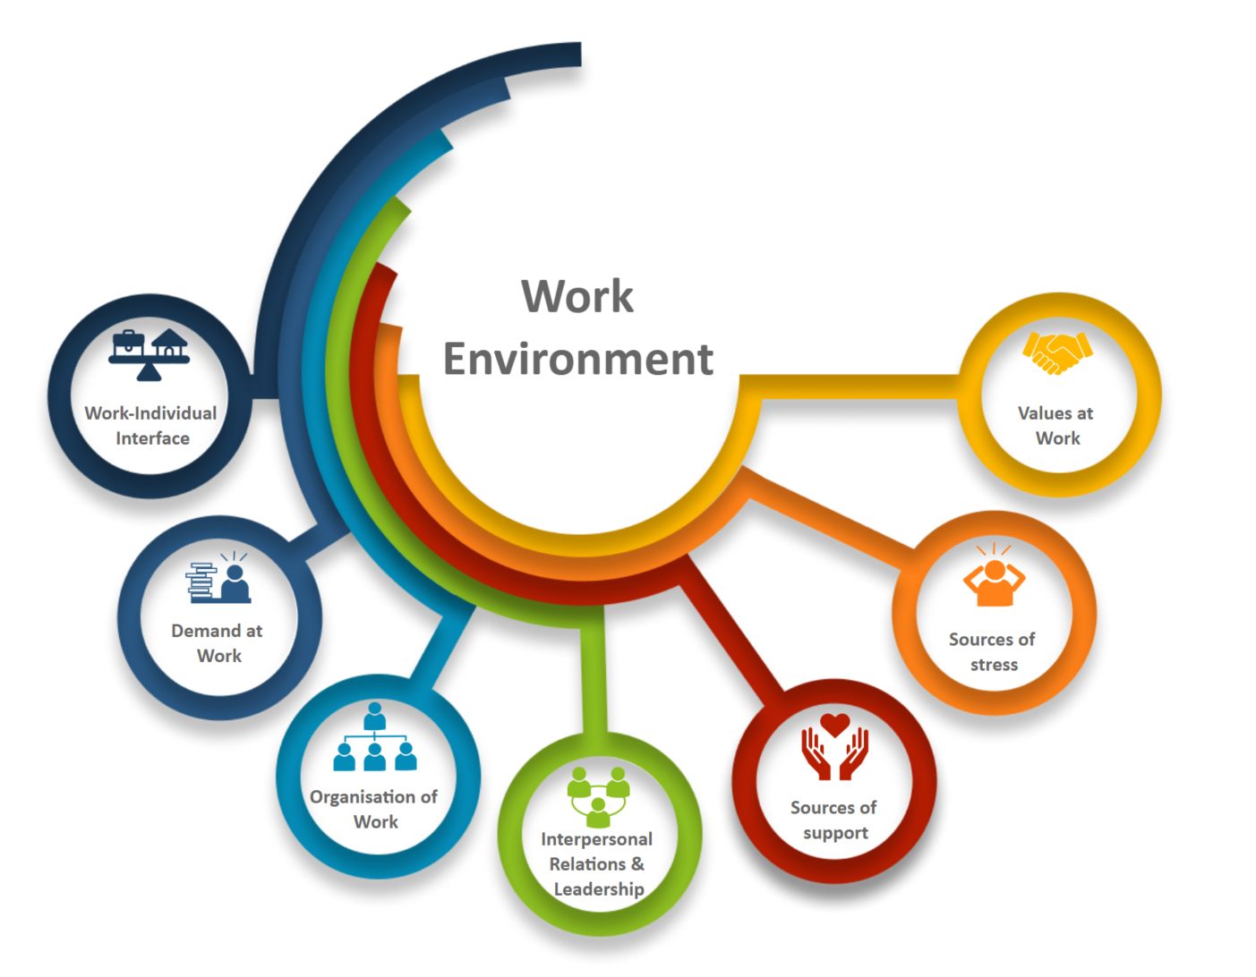
Analytical dashboard
Online Interactive Dashboards
Research Infrastructure: Dashboards
Digital, interactive analysis of the key components of workplace wellbeing
Interactive visualizations of work environment and wellbeing

Slide 42
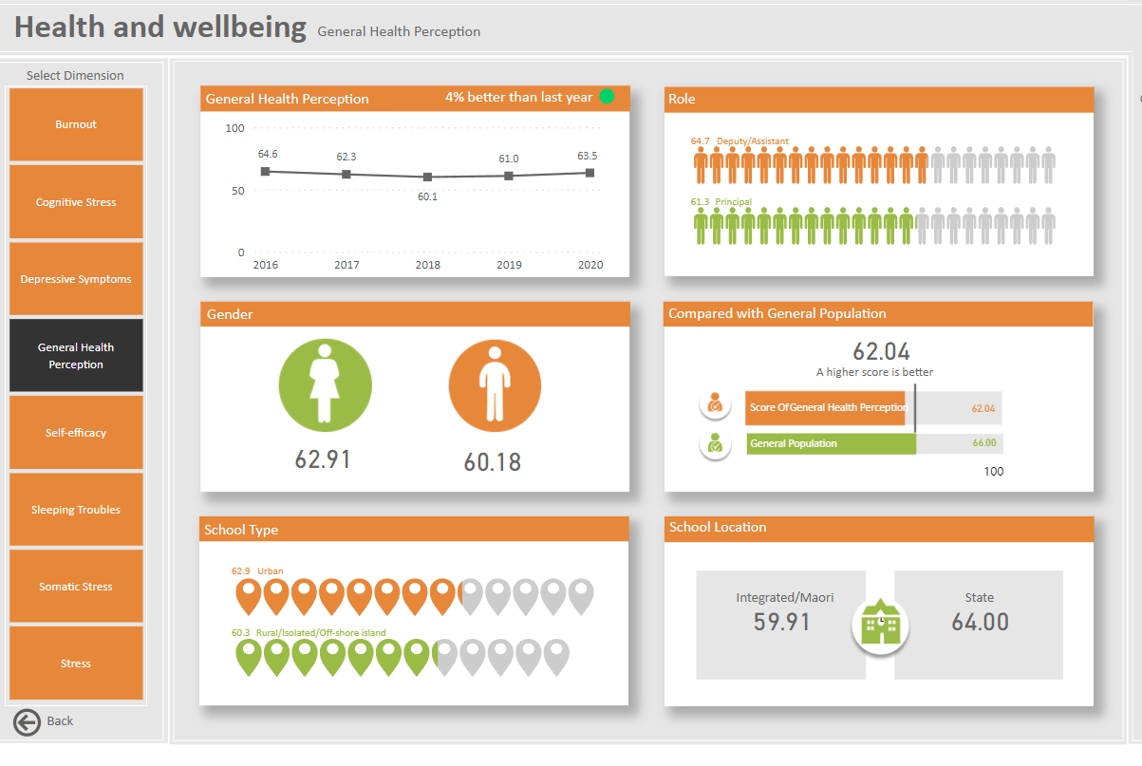
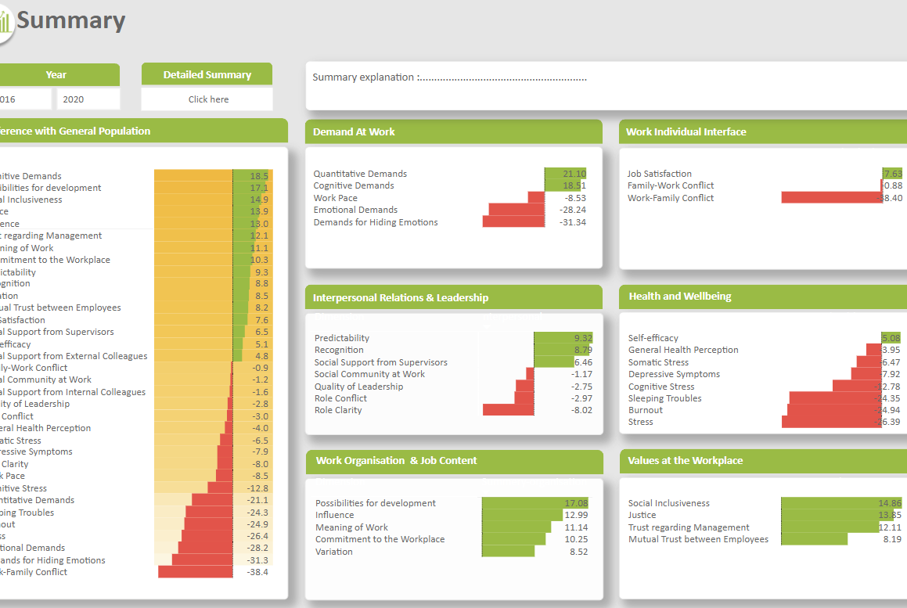
Interactive Infographic Online Dashboards

Slide 43
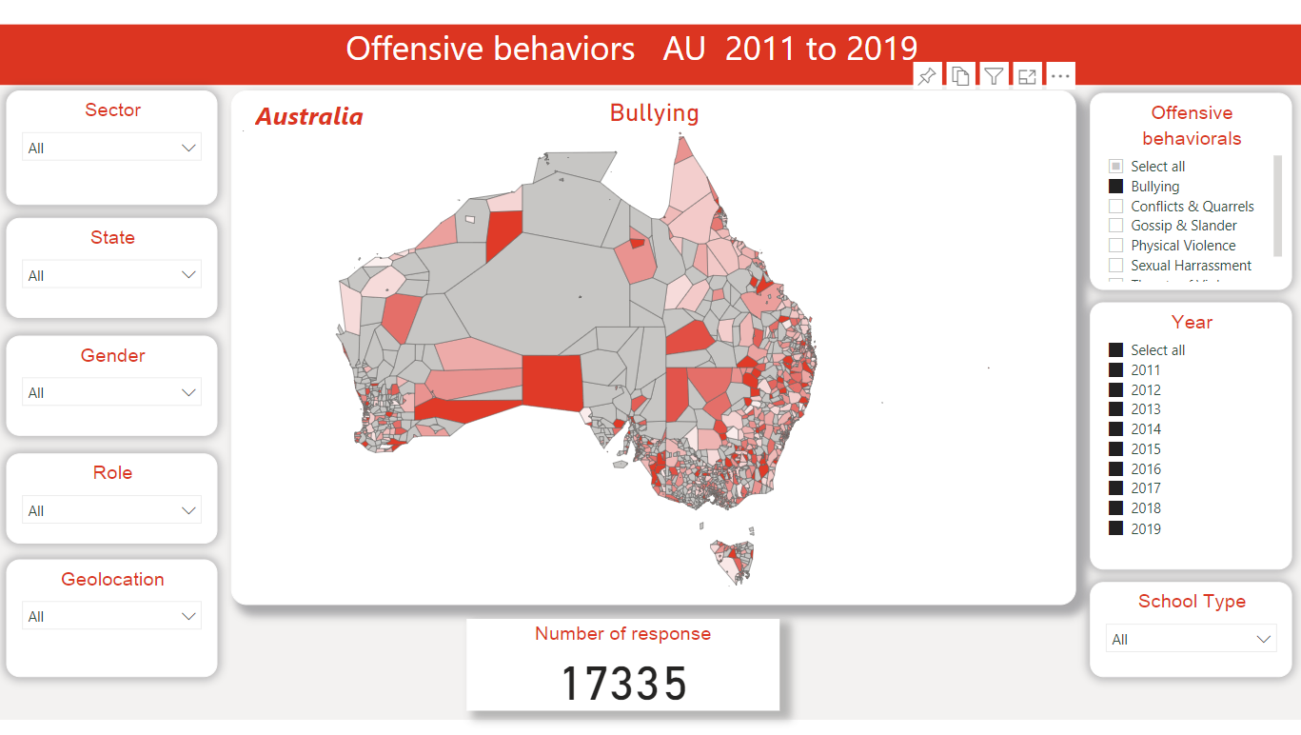
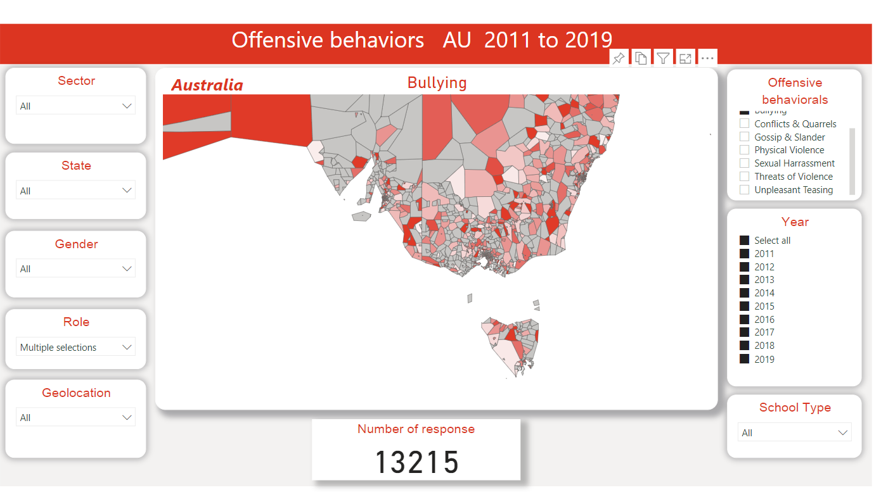
Mapping the results

Slide 44
Contact
Dr Ben Arnold – ben.arnold@deakin.edu.au
Dr Mark Rahimi – m.rahimi@deakin.edu.au
Dr Marcus Horwood – marcus.horwood@deakin.edu.au

Slide 45
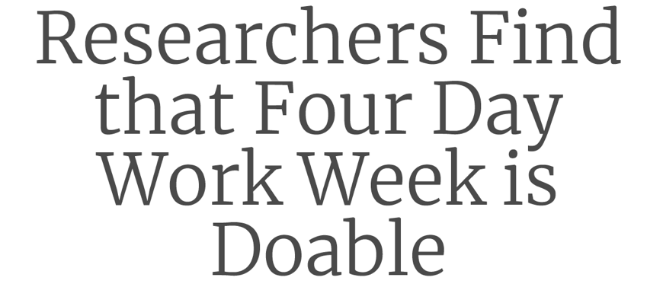
Overview of the Perpetual Guardian 4-day (paid 5) Work Trial
By Professor Jarrod Haar & Dr Helen Delany
Auckland University of Technology
Notes:
Overview of the Perpetual Guardian 4-day (paid 5) Work Trial
By Professor Jarrod Haar & Dr Helen Delany
Auckland University of Technology

Slide 46
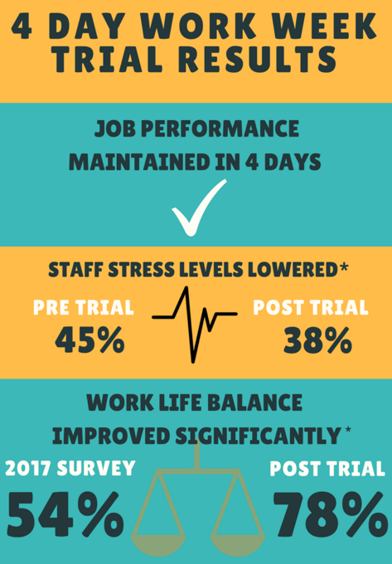

Slide 47
